Slide 1
Cat Breed Classification
Rujia Yuan (Jade)

Slide 2
Problem Statement
The purpose of this project is to develop an efficient and accurate cat breed classification model using a dataset containing images of five common cat breeds: Bengal, Domestic Shorthair, Maine Coon, Ragdoll, and Siamese. The successful implementation of this model will have significant practical implications in various domains, including pet adoption platforms, veterinary clinics, and animal research.
Accurate classification of cat breeds can greatly facilitate the pet adoption process by enabling potential adopters to search for specific breeds of interest. Additionally, the model can aid veterinary clinics in improving diagnoses and treatments by identifying breed-specific health issues. Furthermore, it can contribute to breed-specific research, enabling in-depth studies on the behavior, traits, and genetic variations of different cat breeds. Moreover, businesses can leverage the model to enhance the marketing of breed-specific products, meeting the demands and preferences of cat owners more effectively.
To evaluate the model's performance, metrics such as accuracy, precision, recall, and F1 score will be utilized. These metrics provide insights into the model's overall accuracy, its ability to correctly identify specific breeds, and the balance between precision (exact breed identification) and recall (ability to detect all instances of a breed).

Slide 3
Assumptions/Hypotheses
About data:
Image Quality: Assumed that the dataset contains high-quality images with sufficient resolution, clarity, and minimal noise.
Breed Diversity: Assumed that the dataset contains a diverse representation of each cat breed, encompassing different variations within each breed.
Balanced Class Distribution: Hypothesized that the dataset has a balanced distribution of samples across the cat breeds. There is no significant imbalance.
Consistent Labeling: Assumed that the dataset has been accurately labeled with the correct cat breed for each image.
About model:
Deep Convolutional Neural Networks (CNNs): Assumed that deep CNN architectures will be suitable for this task.
Transfer Learning: Hypothesized that transfer learning from pre-trained models on image datasets will be effective in cat breed classification.
Data Augmentation: Hypothesized that applying data augmentation techniques, such as rotation, scaling, and flipping, will be beneficial in mitigating the limited dataset size.
Softmax Classifier: Assumed that using a softmax classifier in the final layer of the model will be effective for multi-class cat breed classification.

Slide 4
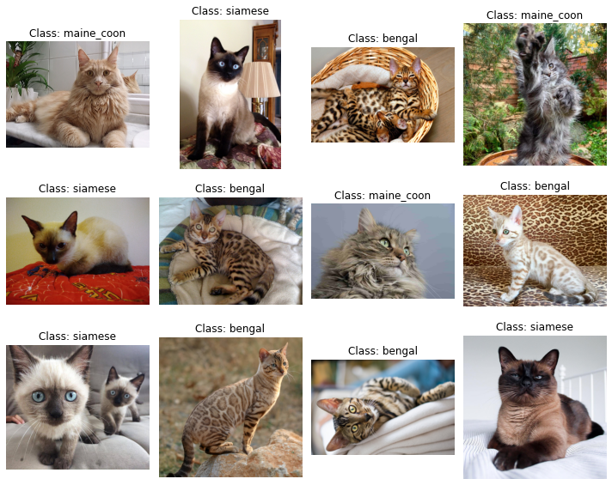
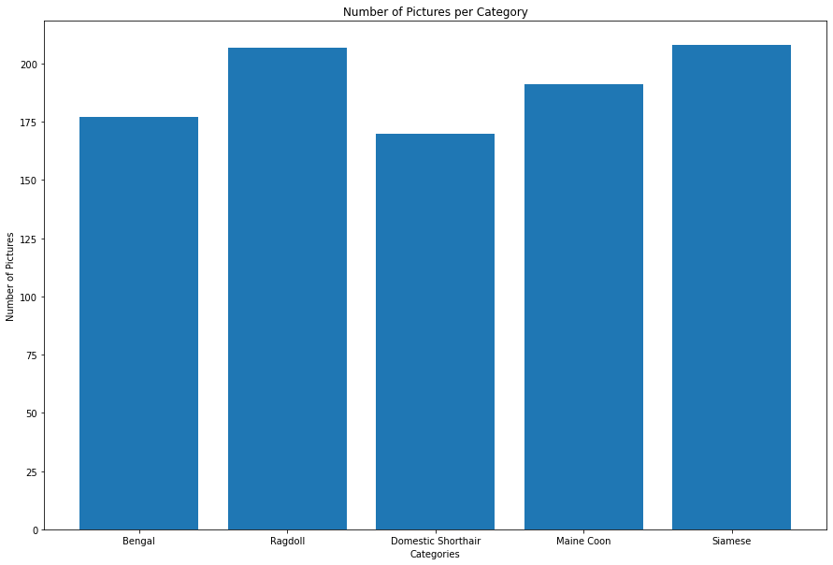
Exploratory Data Analysis
Plot 1: Number of Images per Category
(The 5 category numbers don’t have many differences, so it is in balanced class (category) distribution)
Plot 2: Data Examples
(Above we can see 12 pictures with labels randomly chosen from train generator)

Slide 5
Feature Engineering & Transformations
Resizing: The images are resized to a fixed size of 128x128 pixels.
Normalization: The pixel values of the images are normalized by dividing them by 255.0, which scales the values to the range of [0, 1].
Balanced Class Distribution: Hypothesized that the dataset has a balanced distribution of samples across the cat breeds. There is no significant imbalance.
One-Hot Encoding: The labels are one-hot encoded using LabelBinarizer from sklearn.preprocessing. This transforms the categorical labels into binary vectors.

Slide 6
Feature Engineering & Transformations
Data Augmentation
datagen = ImageDataGenerator(
rotation_range=20,
width_shift_range=0.2,
height_shift_range=0.2,
shear_range=0.2,
zoom_range=0.2,
horizontal_flip=True,
vertical_flip=True,
fill_mode='nearest’
)
Random rotations can be applied within the range of -20 to +20 degrees.
Random shifts can be applied within the range of -20% to +20% of the image width.
Random shifts can be applied within the range of -20% to +20% of the image height.
Random shearing can be applied within the range of -20 to +20 degrees.
The images can be randomly zoomed in or out by up to 20%.
The images can be flipped horizontally.
The images can be flipped vertically.
New pixels will be filled in with the nearest existing pixel value.

Slide 7
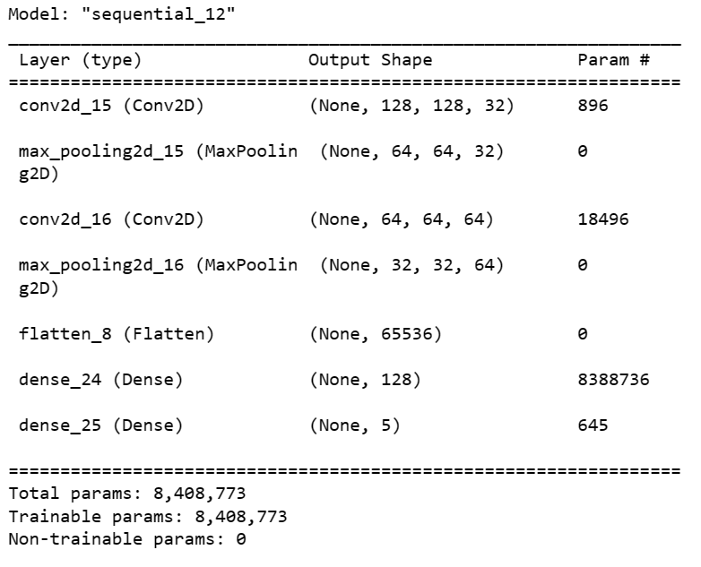
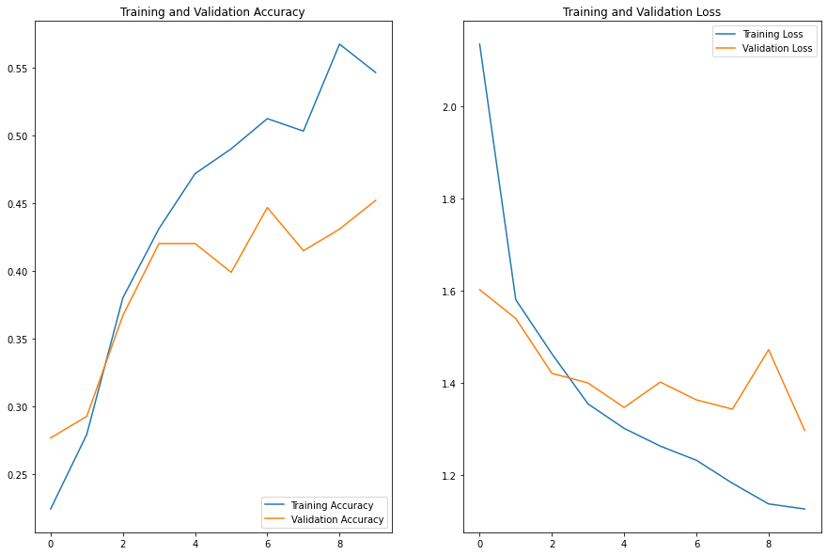
Model 1: Baseline Model
Train & Test Split: 20% of the training data (188 images) are randomly selected as a validation set (test set), while the remaining 80% (763 images) will be used for training.
Baseline Model: A convolutional neural network with two convolutional layers followed by max pooling, a flatten layer, and two dense layers. It has a total of 8,408,773 parameters, all of which are trainable.
Model Compile & fit: Use Adam as optimizer, sparse categorical cross-entropy as loss function, accuracy metric as evaluation, epochs as 10.
Model Checks: There is no clear underfitting / overfitting.
Model Selection: Since this baseline model has low accuracy scores for both training and validation data, I will continue testing new models to see whether the new models perform better.

Slide 8
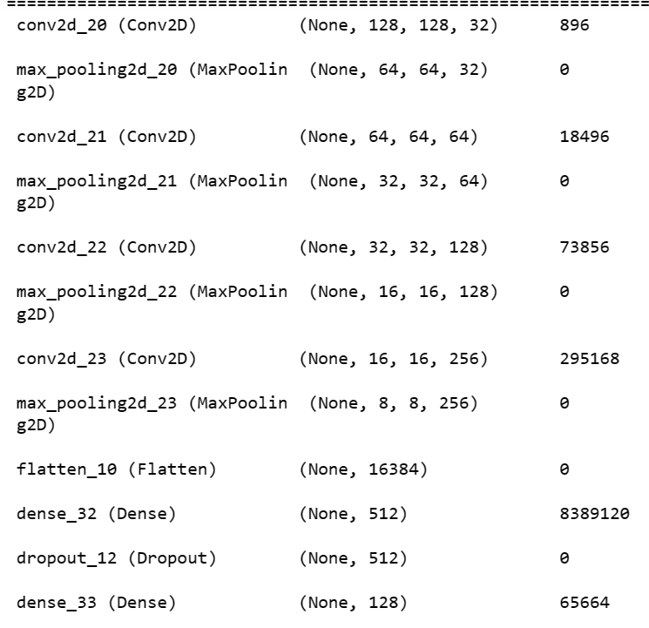
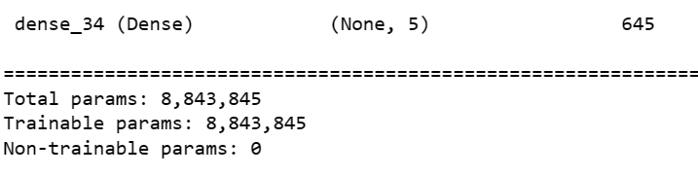
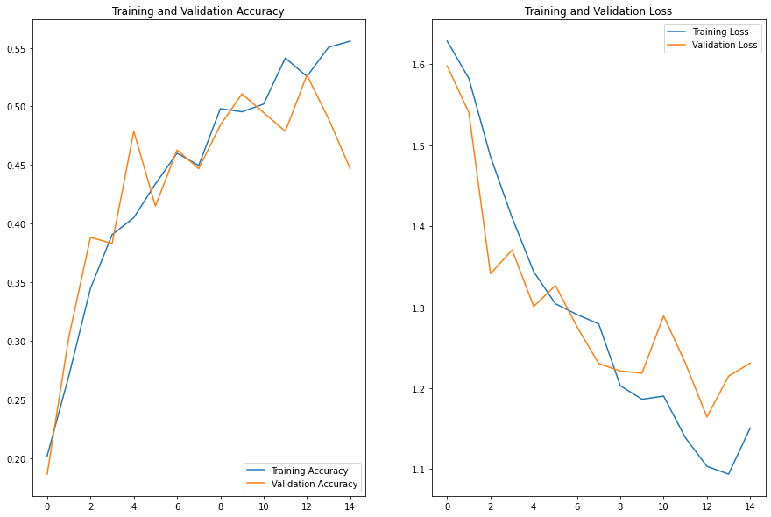
Model 2: Developed Model
Developed Model: A convolutional neural network with four convolutional layers followed by max pooling, a flatten layer, and three dense layers. It has a total of 8,843,845 trainable parameters, making it a more complex and potentially more powerful model compared to the previous ones. The additional convolutional layers adds more complexity & depth to the network, allowing it to learn more intricate features from the input data.
Model Compile & fit: Compile = previous; Epochs = 15.
Model Checks: There is no clear underfitting nor overfitting. Validation accuracy drops at epoch 15.
Model Selection: Since this new developed model still has low accuracy scores for both training and validation data, I decide to try transfer learning method instead of just adding layers.

Slide 9
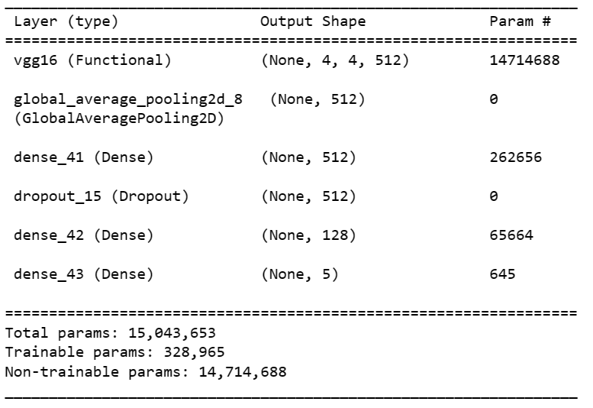
Model 3: VGG16 Model
Model with VGG16 (Transfer Learning): The new model is based on the VGG16 architecture and consists of a pre-trained VGG16 model with its fully connected layers replaced by additional dense layers. It has a total of 15,043,653 parameters, with 328,965 trainable parameters. The model uses global average pooling to reduce the spatial dimensions before passing the features to the dense layers for classification.
Model Compile & fit: Compile = previous; Epochs = 20.

Slide 10
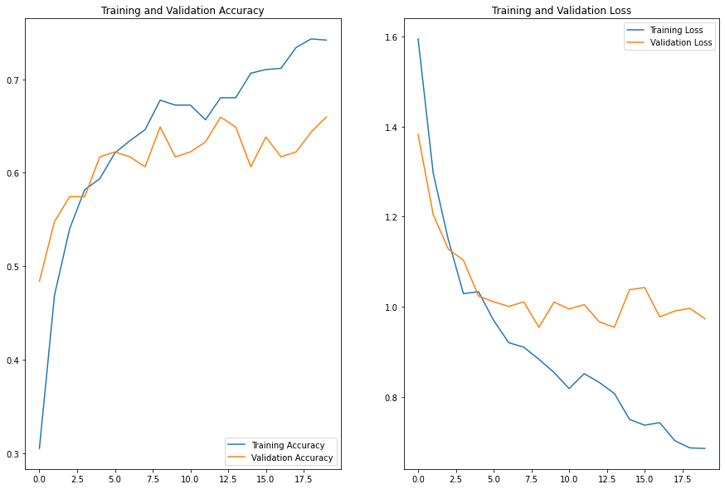
Model 3: VGG16 Model
Model Checks: There is no obvious overfitting or underfitting. After epoch 12, the model may face a little overfitting, since the training accuracy continues increasing, while the validation accuracy fluctuated up and down.
Model Selection: The model with VGG16 has obviously better results than the previous models. It is the first time that validation accuracy has achieved above 60. Adding VGG16 works. Next, I will add hyperparameter tuning to this model using random search to see whether it could work better.

Slide 11
Hyperparameter Tuning
Random Search CV – resulting in the best & final model (model4)
build_model: Previous model 3 (the one with VGG16). The hyperparameters dropout rate as 0.02, and learning rate as 0.001 are specified here.
param_grid: It includes the hyperparameters epochs with three values 10, 20, and 25. It also includes batch size with two values 32 and 64.
RandomizedSearchCV: It is called with the build_model and param_grid. It includes the number of cross-validation folds (cv) as 3, a random seed as 42, and scoring metric as accuracy. It performs a randomized search over the specified parameter grid and evaluates the model's performance using cross-validation.
Best Parameters: epochs = 10; batch size = 32.
Best accuracy score: 0.8254593014717102.

Slide 12
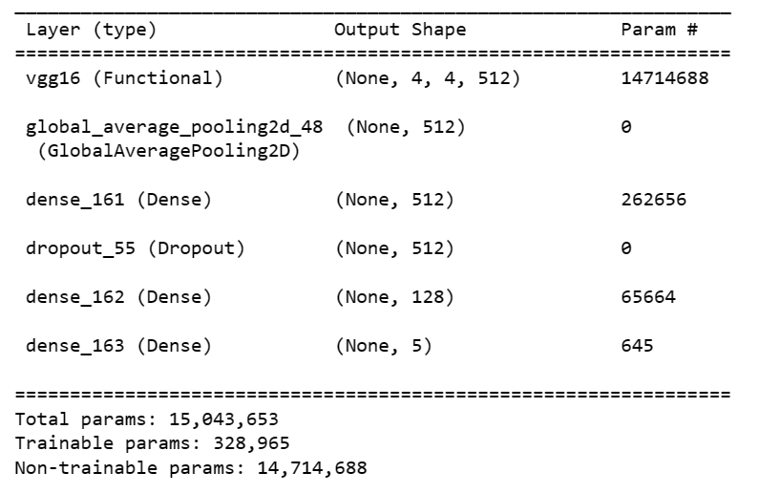
Model 4: Final Model
Train & Test Split: 20% of the training data (188 images) are randomly selected as a validation set (test set), while the remaining 80% (763 images) will be used for training. X and y are split, as x represents features, while y represents labels. (bengal, domestic shorthair, maine coon, ragdoll, siamese)
Final Model: Shown in the right.
Model Compile & fit: Use Adam as optimizer, categorical cross-entropy as loss function, accuracy metric as evaluation, epochs as 10.

Slide 13
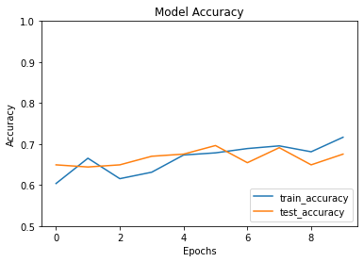
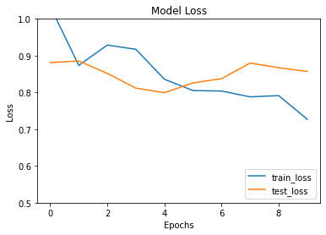
Model 4: Final Model
Model Checks: There is still no obvious overfitting or underfitting. We will check confusion matrix and classification reports latter for better analyzing.
Model Selection: Both train accuracy and test accuracy are higher than before, and the test accuracy approaches 0.7. Since the dataset is complicated and does not contain a lot of images, an accuracy of 0.7 is quite good.

Slide 14
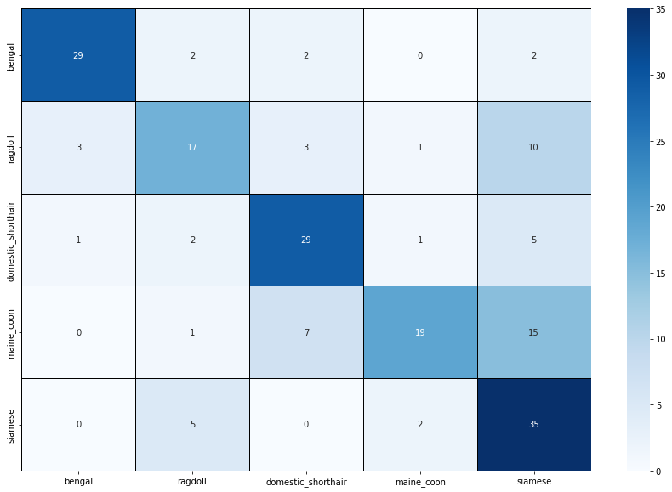
Results & Learning (Model4)
Confusion Matrix for Testing:
Bengal, Domestic Shorthair, Siamese has relatively high numbers of correctly predicted samples (true positives). Ragdoll and Maine Coon do not have good true positives.
Ragdoll, Maine Coon have larger count of samples that belong to the true class but were predicted wrong (false positives).
Siamese has larger count of samples that mistakenly be thought as Siamese, but true classes are others.
Overall: Bengal and Domestic shorthair predicts more accurately, while other three has lower accuracy.

Slide 15
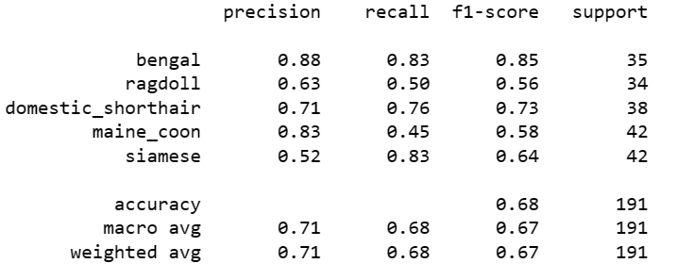
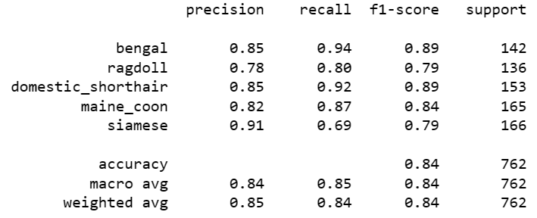
Results & Learning (Model4)
Classification Report for Testing:
Overall: Bengal and Domestic shorthair shows relatively higher scores in precision, recall, and f1 scores. Ragdoll, Maine Coon, Siamese sometimes look similar, so this might be the reason why they have relatively lower scores.
Classification Report for Training:
Overall: All breeds seem performed well, while Ragdoll still have lower precision score and Siamese have lower recall score.
Overfitting?: From two classification reports, there seems to be a slight indication of overfitting in the model. But it is not that obvious.

Slide 16
Future Work
To further improve the accuracy and enhance predictions in the future, several potential enhancements can be considered:
1. Increase the size of the dataset: Since the Cat Breed Dataset consists of only 951 images, acquiring a larger dataset (e.g., 5,000+ images) would provide more training data for the models, enabling them to learn more effectively and potentially improve prediction results.
2. Explore additional neural network architectures: It would be beneficial to experiment with newer architectures like AlexNet, ResNet, Inception, and EfficientNet. By comparing and evaluating different architectures, it becomes possible to identify the one that strikes the best balance between accuracy and computational efficiency.
3. Perform hyperparameter tuning on a wider range of parameters: Expanding the search space by including more values for parameters such as learning rate, dropout rate, batch size, and other relevant factors can help in finding the optimal combination. Techniques like random search or other hyperparameter tuning methods can be utilized to identify the best-performing model configuration.

Slide 17
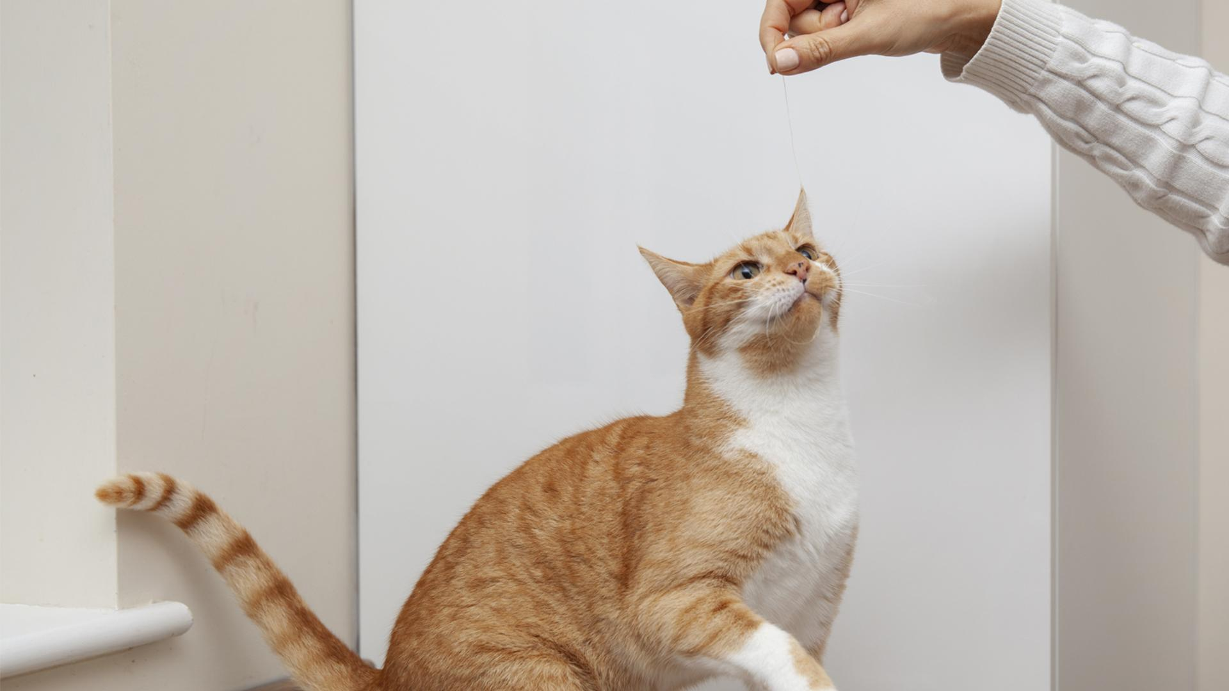
A lot of thanks!
If you are interested in the codes and want to explore more, please just click the link below:
RujiaYuan/Cat-Breed-Classification (github.com)

